Slide 1



Dogs, Chickens, and Muffins
A lesson in Model Evaluation and Selection through Predictive Analytics
By: Group 2
Qihang Li, Yiran Li, Qingyun Lu, Enrique Olivo, and Saaya Yasuda

Slide 2
Presentation Outline
Project Goals
Model Selection
Final Model Proposal
Test Data Results

Slide 3

Project Goals
Propose a feasible improvement over a client’s current practice of predicting between dogs, chickens, and muffins.
Base feasibility on:
Storage/Memory Cost
Test Running Time Cost (computational efficiency)
Base improvement on:
Predictive Power (accuracy and error rates)

Slide 4

Model Selection: Baseline (GBM +SIFT)
Our client’s current practice of using Boosted Decision Stumps on SIFT Features yield the following summary findings, based on data of 3000 images.
Error Rate: 33.3%
Running Time : 3270.6 seconds (54.5 minutes)

Slide 5
Model Selection: Classifiers & Features
In order to find the best improvement for our client’s model, we tested the following Classifiers on the following Features
Classifiers (Models)
GBM (Baseline)
Multinomial Regression
RandomForest
XGBoost
Features
SIFT (Scale-Invariant Feature Transform) Size: 5000 Columns
SIFT + PCA Size: 100 Columns
LBP (Local Binary Pattern) Size: 59 Columns
HOG (Histogram of Oriented Gradients) Size: 54 Columns
Notes:
Each classifier and each feature had their own merits as potential components to our final proposed model. These merits can be elaborated?

Slide 6
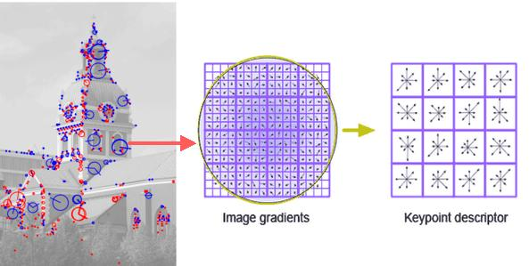
Features: SIFT
Notes:
Each classifier and each feature had their own merits as potential components to our final proposed model. These merits can be elaborated?

Slide 7
Features: SIFT + PCA
Notes:
Reduces the dimensions of SIFT

Slide 8
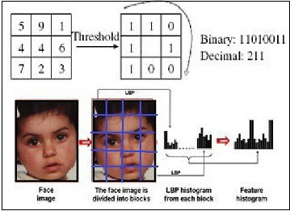
Features: LBP

Slide 9
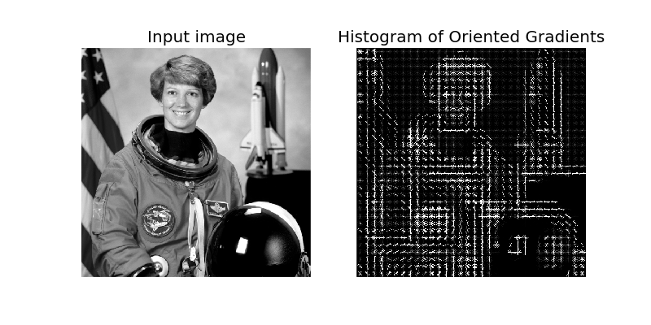
Features: HOG
Notes:
Eileen Collins, first female Space Shuttle pilot

Slide 10
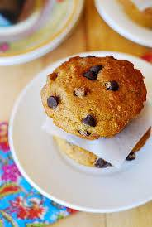
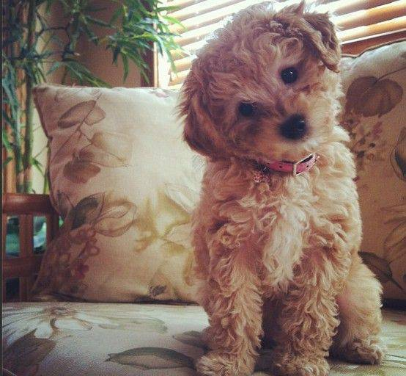
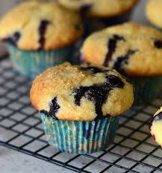
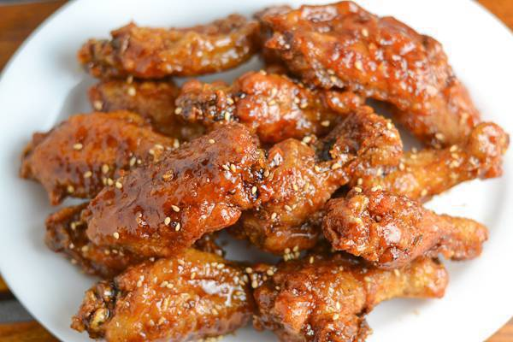
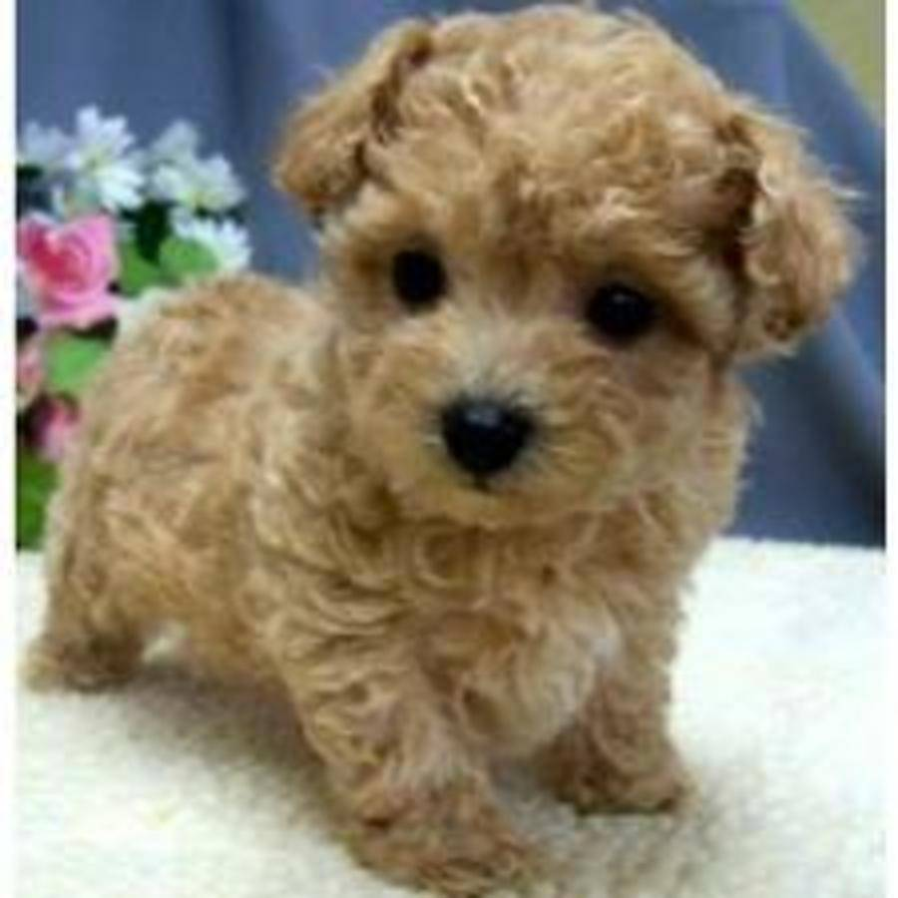
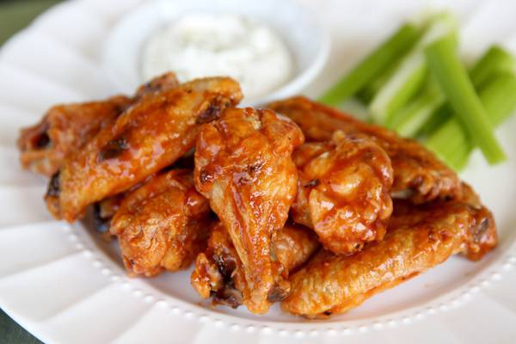
Notes:
Patterns! Muffins = protruding blueberries/chocolate chips. Dogs = fluffy. Chicken = background of a plate

Slide 11
Model Selection: Classifiers & Features
In order to find the best improvement for our client’s model, we tested the following Classifiers on the following Features
Classifiers (Models)
GBM (Baseline)
Multinomial Regression
RandomForest
XGBoost
Features
SIFT (Scale-Invariant Feature Transform)
SIFT + PCA
HOG (Histogram of Oriented Gradients)
LBP (Local Binary Pattern)
Notes:
GBM “boosted decision stumps”, Multinomial Regression, XGBoost tries to better control for overfitting by allowing the optimization of what’s called a differentiable loss function….
RandomForest uses “random supsacing” on a set of features to create decision trees in the learning process.

Slide 12

Model Selection on SIFT Features
GBM (Baseline) | Multinom | RandomForest | XGBoost
Error Rate: 29.7% Running Time: 3270.6 (54.5 minutes) | Error Rate: 27.5% Running Time: 365.568 | Error Rate: 24.8% Running Time: 160.077 | Error Rate: 20% Running Time: 150.70
Note that these error rates and running times are the result of finding the “best” parameters in each model through Cross Validation.

Slide 13

Model Selection on SIFT+PCA Features
GBM (Baseline) | Multinom | RandomForest | XGBoost
Error Rate: 26.7% Running Time: 207.63 | Error Rate: 31.3% Running Time: 0.03 | Error Rate: 20.7% Running Time: 47.755 | Error Rate: 17.33% Running Time: 350.92
Note that these error rates and running times are the result of finding the “best” parameters in each model through Cross Validation.

Slide 14

Model Selection on HOG Features
GBM (Baseline) | Multinom | RandomForest | XGBoost
Error Rate: Running Time: 96 | Error Rate: 19.56% Running Time: 0.706 | Error Rate: 24.53% Running Time: 16.85 | Error Rate: 22% Running Time: 7.03
Note that these error rates and running times are the result of finding the “best” parameters in each model through Cross Validation.

Slide 15
Model Selection on LBP Features
GBM (Baseline) | Multinom | RandomForest | XGBoost
Error Rate: Running Time: 106.56 | Error Rate: 23.7% Running Time: 1.335 | Error Rate: 29.6% Running Time: 27.561 | Error Rate: 27.22% Running Time: 168.69
Note that these error rates and running times are the result of finding the “best” parameters in each model through Cross Validation.

Slide 16
Final Model
After comparing several different Classifiers and Models, we decided on using XGBoost (Extreme Gradient Boosting) with SIFT FEATURES.
XGBoost (Results) | XGBoost (Parameters) | GBM Baseline (Results) | GBM Baseline (Parameters)
Error Rate: 17.33% Running Time: 350.92 | max.depth=4 eta=0.1 nthread=2, nround=250 | Error Rate: 29.7% Running Time: 3270.6 (54.5 minutes) | Max.depth = 9 n.Trees = 250

Slide 17
Final Model – Test Data Results
Given the new testing data of 3000 images, the results of our proposed Final Model are below.
Accuracy:
Running Time:

